Slide 1

Behavioural consequences of privacy violation online in a post-communist society
Jelena Budak
Conference ‘Surveillance, Resilience & Privacy’
Paris, December 6, 2018

Slide 2
Privacy resilience of Internet users
Privacy resilience might be understood as how privacy as a system recovers and adapts after being lost by privacy intrusion.
The knowledge on factors influencing privacy resilience and how to measure it is very limited.
This study contributes to the privacy resilience debate by exploring how negative privacy violation experience of internet user is related to privacy concern and what actions could be foreseen in the case of individuals that have been exposed to the privacy breach and those who have not experienced privacy violation.
How individual behaviour is related to the privacy restored after stress
Notes:
Privacy resilience might be understood as how privacy as a system recovers and adapts after being lost by privacy intrusion. The personal privacy resilience is intuitively hard to be (re)established if an individual experienced privacy breaches. The same stand for societies that have lived in the authoritarian regimes under surveillance and with limited privacy. For example post-communist societies are expected to be more prone to privacy concerns and less tolerant to the contemporary surveillance (see for example Webster et al. Eds, 2011; Svenonius and Björklund, 2018). In the privacy resilience research, the recovery to the ‘normal’ state of privacy from the individual point of view is effectuated by personal actions. The knowledge on factors influencing privacy resilience and how to measure it is very limited, if any. This study contributes to the privacy resilience debate by exploring how individual behaviour relates to the privacy restored after stress

Slide 3
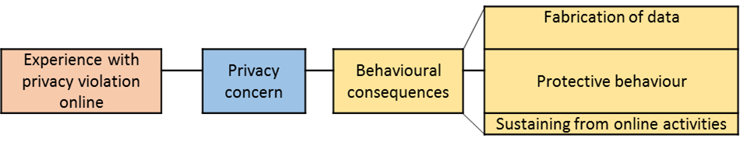
Model
Negative past experience with privacy violation might raise the privacy concern of internet users and lead to the behavioural consequences: fabrication of data, protective actions, and sustaining from online activities.
Notes:
Privacy resilience might be understood as how privacy as a system recovers and adapts after being lost by privacy intrusion. The personal privacy resilience is intuitively hard to be (re)established if an individual experienced privacy breaches. The same stand for societies that have lived in the authoritarian regimes under surveillance and with limited privacy. For example post-communist societies are expected to be more prone to privacy concerns and less tolerant to the contemporary surveillance (see for example Webster et al. Eds, 2011; Svenonius and Björklund, 2018). In the privacy resilience research, the recovery to the ‘normal’ state of privacy from the individual point of view is effectuated by personal actions. The knowledge on factors influencing privacy resilience and how to measure it is very limited, if any. This study contributes to the privacy resilience debate by exploring how individual behaviour relates to the privacy restored after stress

Slide 4
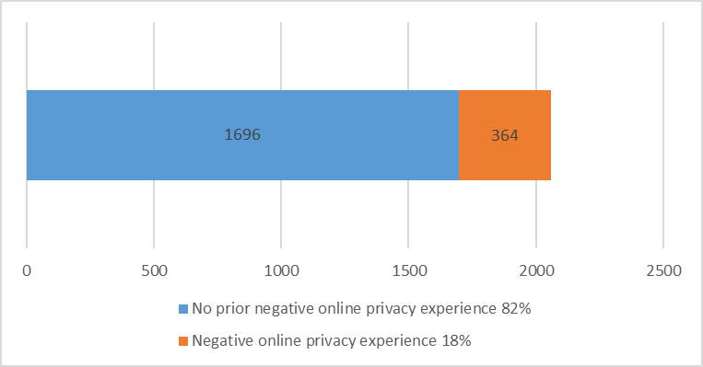
Methodology
survey data on the internet users population in Croatia
CATI interviews in 2016 (N=2060)
questions from the literature on online privacy concern
previous negative experience with privacy violation had
  18% of Internet users

Slide 5
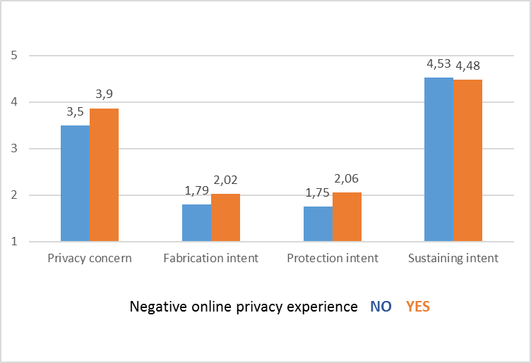
Behaviour consequences
prior negative experience with privacy breaches increases the privacy concerns
Internet users from both groups do not fabricate data when online nor employ protective SW, however, those with bad experience tend to fabricate and protect themselves more
Croatian Internet users claim they sustain from e.g using untrustful web sites and this behaviour is more prevalent among users with no privacy violation experience
Likert type 5-point scale
Mean score from 1-5 calculated

Slide 6
Conclusions
Internet users in Croatia who have been exposed to privacy violation are more privacy concerned and behave more cautiously when online.
The differences in their behaviour when compared to the majority of internet users who had no prior negative experience with privacy breaches are rather small but significant (except for sustaining).
In the context of further research needed there are indications of resilience of privacy because privacy concerns in general are only slightly present.
As far as it considers privacy resilience first insights into behaviour of internet users who have been exposed to stress of privacy violation suggest they easily ‘adapt’ and recover i.e. no major behaviour reactions are taken when compared to the internet users whose privacy had not been stressed.

